Slide 1

Capstone Project-4
Netflix Movie and TV Show Clustering
Project Type - Unsupervised (Clustering, Content Based Recommendation System)
By- Shadab Husain

Slide 2
STEPS INVOLVED:
Steps that are significantly contribute towards
achieving the results:
Defining Problem statement
Introduction
Understanding the data
Exploratory data analysis
Data Cleaning
Textual Data preprocessing
Clusters implementation
Build Recommendation System
Conclusions

Slide 3
Project Goal:
The goal of this project is to classify the Netflix shows into definite clusters such that movie and TV shows that are in the same cluster/group should have related properties or features, while data points in different groups should have highly different properties or features.
Problem Statement:
Netflix is the world's largest online streaming service provider, with over 220 million subscribers as of 2022-Q2. It is crucial that they effectively cluster the shows that are hosted on their platform in order to improve the user experience, thereby avoiding subscriber churn.
We will be able to understand the shows that are related to each other and different from one another by creating clusters, which may be leveraged to offer the consumers adapted show proposals depending on their preferences.

Slide 4
Introduction
Netflix is a company that succeeds a large collection of TV shows and movies, streaming it anytime via online. This business is money making because users make a monthly payment to access the platform. However, customers can cancel their subscriptions at any time.

Slide 5
DATA PIPELINE:
Analyze Data: In this first step we went to look for different features accessible and tried to knowing the data. During this stage, we looked for the shape of data, data types of each feature, statistical summary etc.
EDA: EDA or Exploratory Data Analysis is the serious process of performing the first investigation on the data. So, through this we have detected certain trends and dependencies and drawn certain conclusions from the dataset that will be valuable for further processing.
Data Cleaning: Checked duplicated and null values present in the dataset. After that comes to the outlier detection and treatment. For the null values imputation we simply replace with empty string then analyze outlier and handling.
Textual Data Preprocessing: During this stage, cluster the data based on the attributes: director, cast, country, genre, rating and description. Data preprocessing comprise remove all stop words and punctuation marks, convert all textual data to lowercase. Stemming to generate a meaningful word out of corpus of words. Tokenization of corpus and Word vectorization. We used Principal Component Analysis (PCA) to handle the curse of dimensionality.
Clusters Implementation: Use K-Means and Agglomerative Hierarchical clustering algorithms to cluster the movies, and obtain the best number of clusters using different techniques.
Build Content Based Recommendation System: A content-based recommender system was built using the parallel matrix obtained after using cosine similarity. This recommender system will show 10 recommendations to the user based on the type of movie/show they watched.

Slide 6
ATTRIBUTE INFORMATION:
DATASET SUMMARY:
This dataset consist of movie and TV shows available on Netflix till 2020.
The dataset contained about 7787 records and 12 attributes.
Most of the features are Present in textual format.
Dataset contains two type of content one is Movie and another one is TV show.
Show Id : Unique ID for every Movie/Show
Type : Identifier - Movie/Show
Title : Title of the Movie/Show
Director : Director of the Movie/Show
Cast : Actors involved in the Movie/Show
Country : Country where the Movie/Show was produced
Date Added : Date it was added on Netflix
Release Year : Actual Release year of the Movie/Show
Rating : TV Rating of the Movie/Show
Duration : Total Duration - in minutes or number of seasons
Listed In : Genre
Description : The Summary description

Slide 7
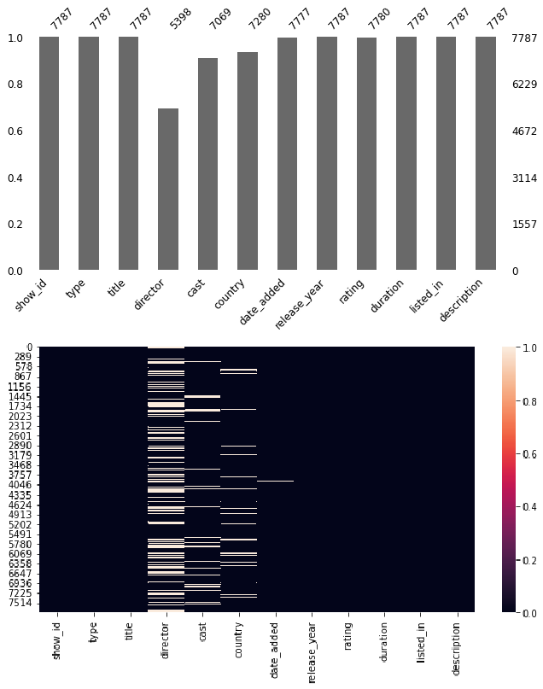
Null Values Treatment:
Null values present in the director, cast, country, date_added and rating column.
All the data that we have is related to each specific movie. So, we can't impute any null values with using any method. Also, we don't want to lose any data since the data size is small for that reason.
The null values in the director, cast, and country attributes can be filled with unknown
Small amount of null value percentage present in rating and date_added column, if we drop these nan values it will not affect that much while building the model.

Slide 8
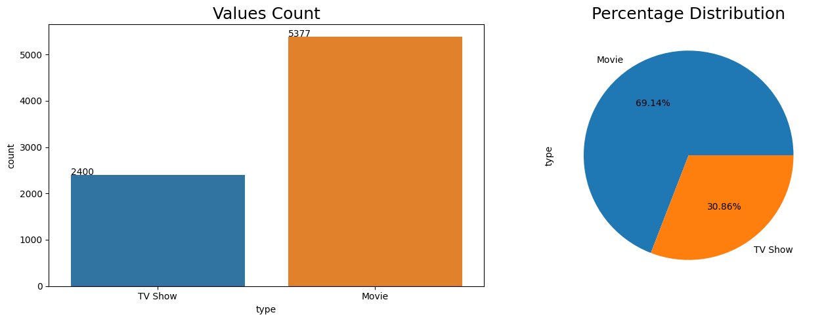
EXPLORATORY DATA ANALYSIS: (Type Column)
There are a larger number of count in Movie than TV Show.
69.14% of data belong from Movie class and 30.86% of data belong from TV shows.

Slide 9
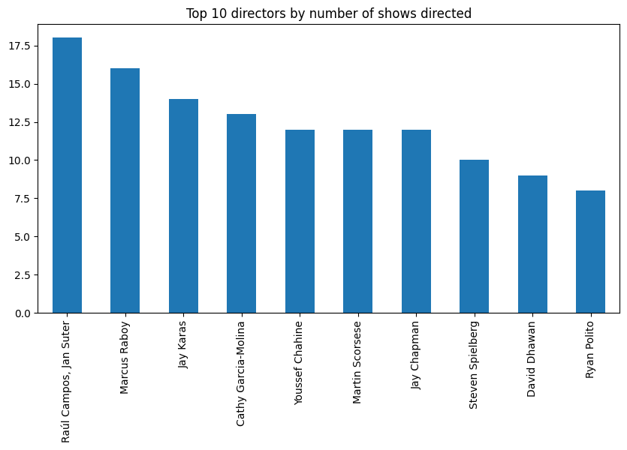
EXPLORATORY DATA ANALYSIS: (Director column)
Raul Campos and Jan Suter collected have directed 18 shows, it is higher than anyone in the dataset while Ryan Polito has directed least shows.

Slide 10
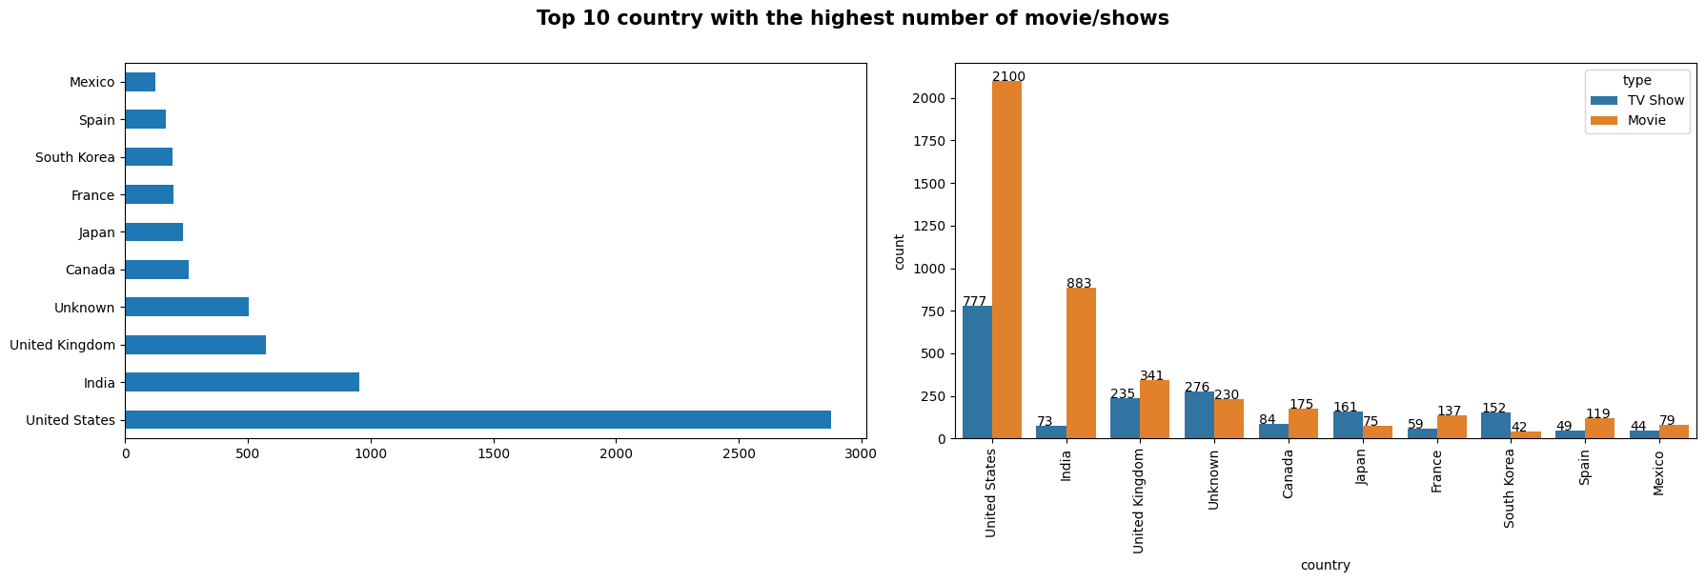
EXPLORATORY DATA ANALYSIS: (type)
The maximum number of movies / TV shows were based out of the US, followed by India and UK.
The top 10 countries collected account for about 63% of all movies and TV shows in the dataset.
In India and United State, a larger number of movie present compared to TV show.
Larger number of count in TV shows belong from US while least in mexico.

Slide 11
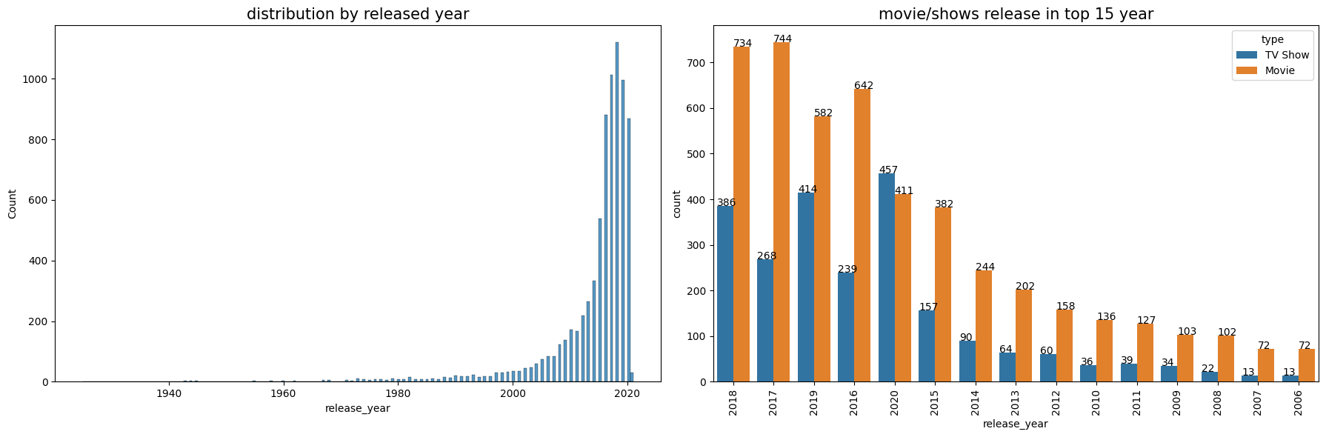
EXPLORATORY DATA ANALYSIS: (Release_Year column)
Netflix has larger number of new movies / TV shows than the old ones.
Maximum number of movie/shows are released in Netflix in between 2015-2020 and maximum number of count belong from 2018 year.

Slide 12
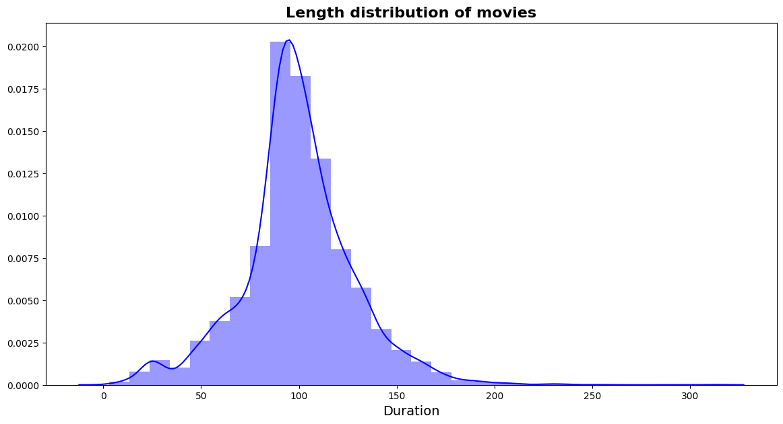
EXPLORATORY DATA ANALYSIS:(Duration)
in this plot we originate the Length distribution of movies duration. we see 0 to 100 duration movies are rises and 100 to 200 duration are decreases.

Slide 13
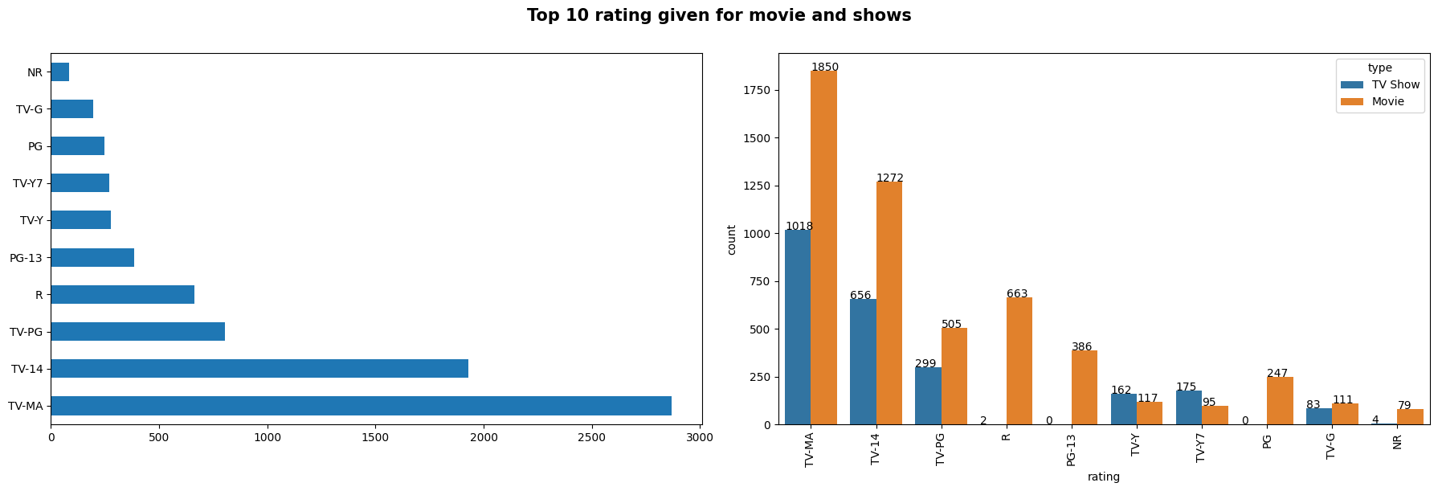
EXPLORATORY DATA ANALYSIS: (Rating column)
TV-MA : Mature Adults
R : Adults
PG-13 : Teens
TV-14 : Young Adults
TV-PG : Older Kids
NR : Adults
TV-G : Kids
TV-Y : Kids
TV-Y7 : Older Kids
PG : Older Kids
Most of the Movies and tv shows have rating of TV-MA (Mature Audience) then followed by TV-14 (younger audience).
Maximum number of rating given for the movies it is obvious because of maximum number of category belong from Movie class as we can seen in type column.

Slide 14
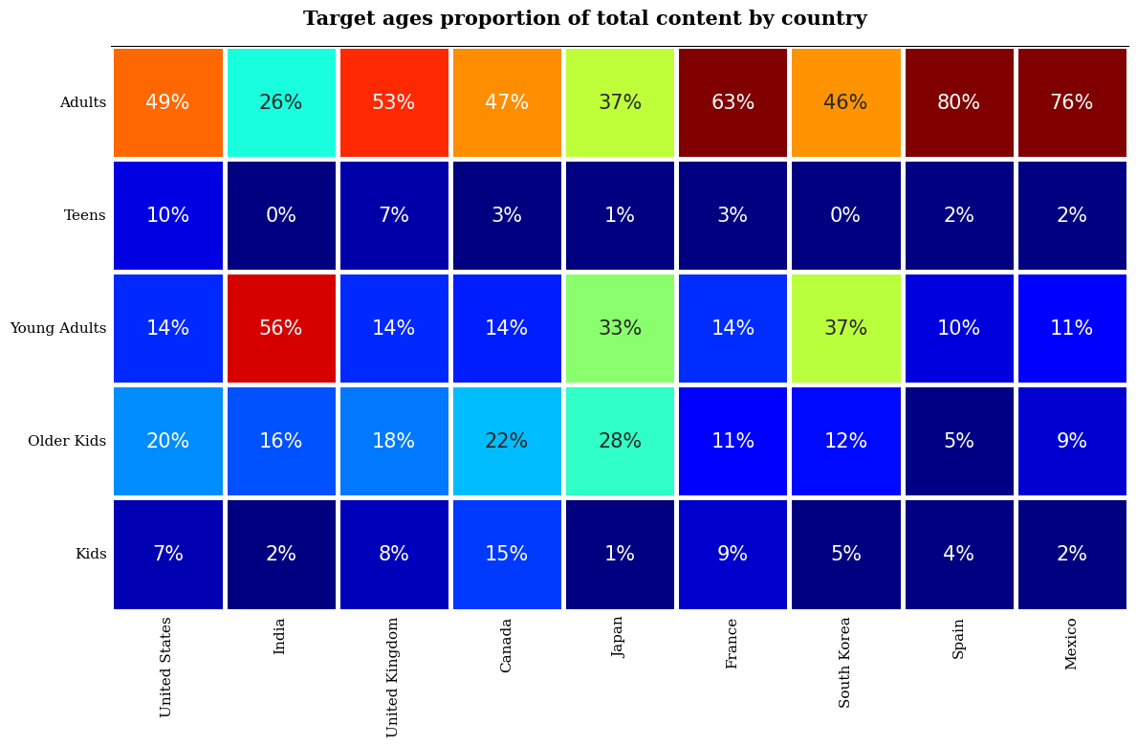
EXPLORATORY DATA ANALYSIS: (Heatmap)
To know the correlation between all the variables along with the correlation coefficients, i used correlation heatmap.
In this correlation Heatmap graph we originate the Target ages fraction of total content by country.

Slide 15
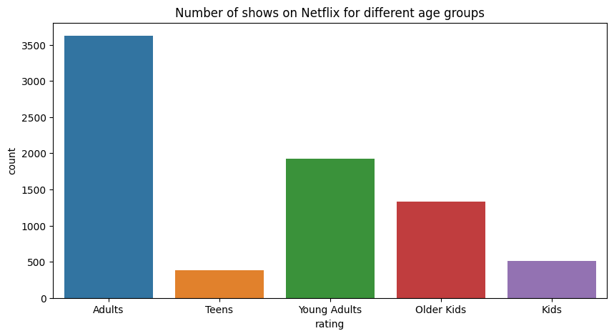
EXPLORATORY DATA ANALYSIS: (Age)
Countplot() method is used to Display the counts of observations in each categorical bin using bars.
In this count plot we originate that Number of shows on Netflix for diverse age groups and Adults are the maximum number of shows and second maximum is Young Adults and third maximum is older Kids shows.

Slide 16
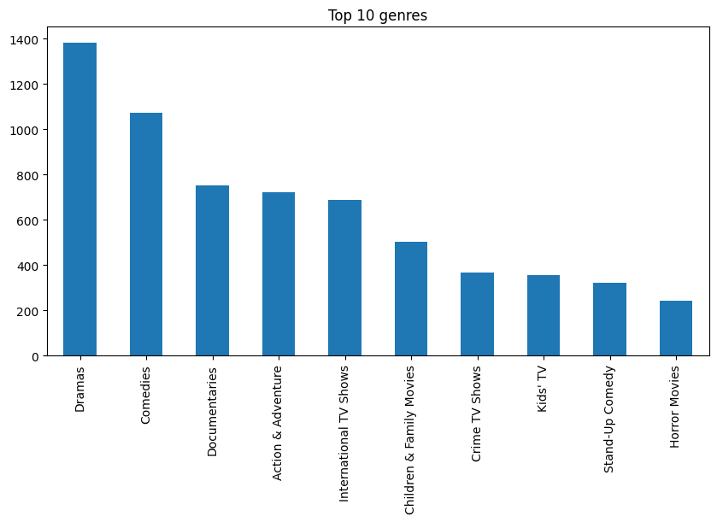
EXPLORATORY DATA ANALYSIS: (Genre)
A bar graph is a graphical representation of data in which we can focus to the category with particular shapes like a rectangle. The length and heights of the bar chart signify the data distributed in the dataset. In a bar chart, we have one axis signifying a particular category of a column in the dataset and another axis signifying the values or counts related with it. Bar charts can be plotted vertically or horizontally. A vertical bar chart is often called a column chart.
In this bar plot we found Dramas are large value_counts of shows and movies and Comedies are the second large value_counts of shows and Movies.

Slide 17
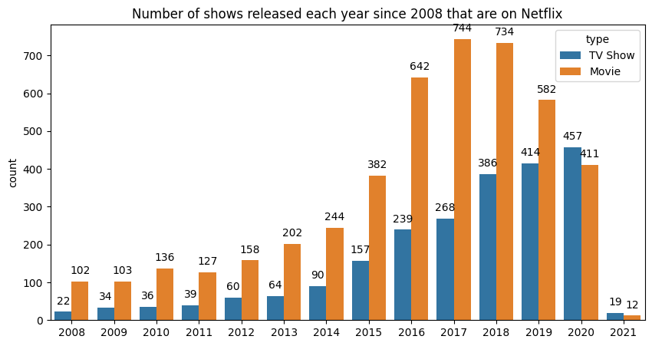
EXPLORATORY DATA ANALYSIS: (Type)
A bivariate plot graphs the relationship between two variables that have been measured on a single sample of subjects. Such a plot permits you to see at a glance the degree and pattern of relation between the two variables.
In this graph we originate that Number of shows released each year since 2008 that are on Netflix. See this graph Before 2019 Movies are maximum number of released but 2020 and 2021 TV shows are the highest number of released.

Slide 18
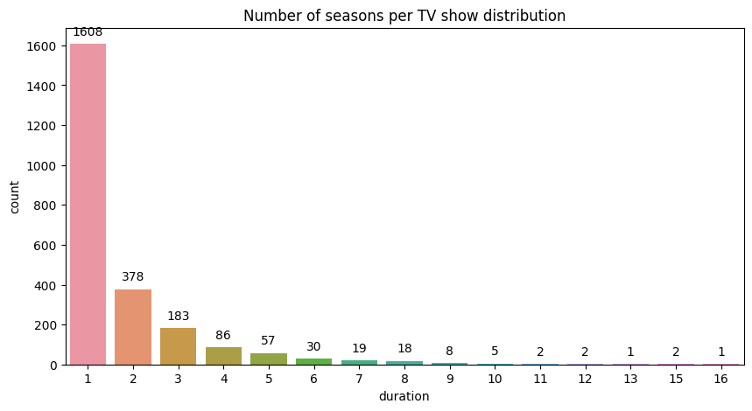
EXPLORATORY DATA ANALYSIS
A count plot can be assumed of as a histogram across a categorical, instead of quantitative, variable. The basic API and options are equal to those for barplot() , so you can relate counts across nested variables.
In this graph we originate Number of per Seasons in each TV show count. First seasons are 1608 and second seasons are 378 and third seasons are 183 number of counting are there.

Slide 19
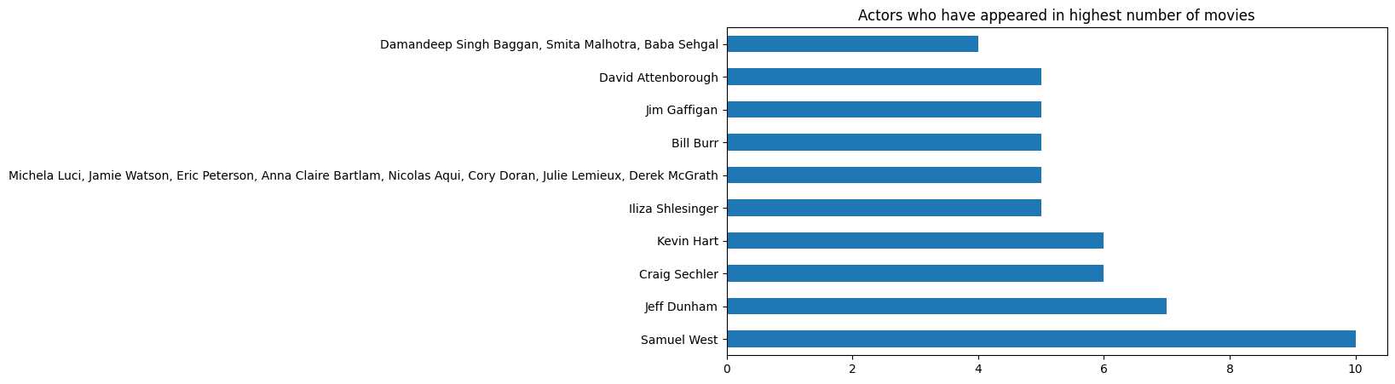
EXPLORATORY DATA ANALYSIS: (Cast)
A horizontal bar plot is a plot that presents quantitative data with rectangular bars with lengths proportional to the values that they represent. A bar plot shows comparisons among discrete categories. One axis of the plot shows the specific categories being compared, and the other axis represents a measured value.
In this graph we found Top actors for movies. Top one actor in movies are Samuel West and second highest actor are jeff Dunham and third highest actor of movies are Craig Sechler and Kevin Hart.

Slide 20
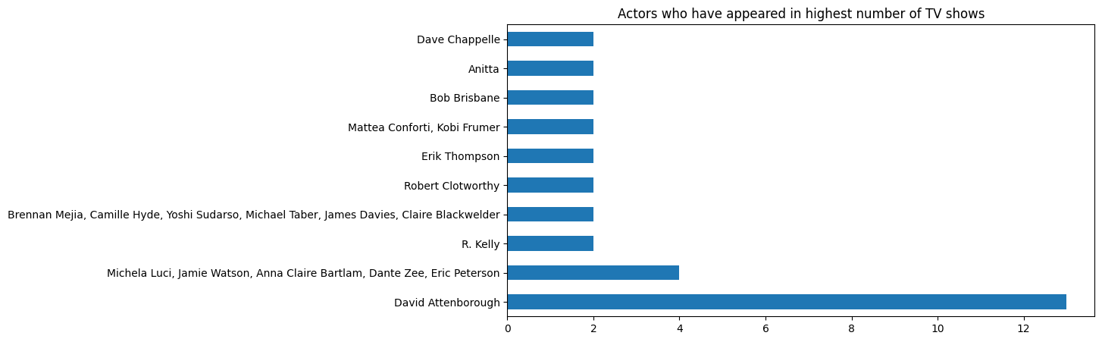
EXPLORATORY DATA ANALYSIS: (Cast)
A horizontal bar plot is a plot that presents quantitative data with rectangular bars with lengths proportional to the values that they represent. A bar plot shows comparisons among discrete categories. One axis of the plot shows the specific categories being compared, and the other axis represents a measured value.
In this graph we found Actors who have appeared highest number of TV shows. Top one actor of TV Shows is David Attenborough and second highest actor in TV shows many are there like Michela Luci,Jamie Watson,Anna Claire Bartlam,Dante Zee and Eric peterson.

Slide 21
Modeling Approach:
Select the attributes based on which you want to cluster the shows
Text preprocessing: Eliminate all stop words and punctuation marks, change all textual data to lowercase.
Stemming to make a meaningful word out of corpus of words.
Tokenization of corpus and Word vectorization
Dimensionality reduction
Use different algorithms to cluster the movies, get the optimal number of clusters using different techniques
Build optimal number of clusters and visualize the contents of each cluster using word clouds.
Cluster:
We create one cluster column based on the following features:
Director
Cast
Country
Rating
Listed in (genres)
Description

Slide 22
Before clusters implementation we essential to pre-process the data. So that we filtered data with following steps:
Removing Stop words
Stop words are common words like “the”, “and” and “but” do not convey much meaning on their own and are
often seen as noise in the data.
Lowercasing words
Lowercasing the words can also reduce the size of the vocabulary, which can make it easier to work with longer texts .
Removing Punctuation
Punctuation marks like periods, commas, and exclamation points can add noise to the data and can sometimes be treated as separate tokens, which can disturb the performance of NLP models.
Stemming
used Snowball Stemmer to generate a meaningful word out of corpus of words.
For example, the words "run," "runs," "ran," and "running" are all different inflected forms of the same word "run," and a stemmer can shrink them all to the base form "run."
Tokenization of corpus and Word vectorization – TFIDF
1. This is important in NLP tasks because most machine learning models expect numerical input and cannot work with raw text data directly. Word vectorization allows you to input the words into a machine learning model in a way that preserves the meaning and context of the words.
Dimensionality reduction – PCA
Dimensionality reduction is the process of decreasing the number of features or dimensions in a dataset while preserving as much information as possible. As high-dimensional datasets can be hard to work with and can sometimes suffer from the curse of dimensionality.

Slide 23
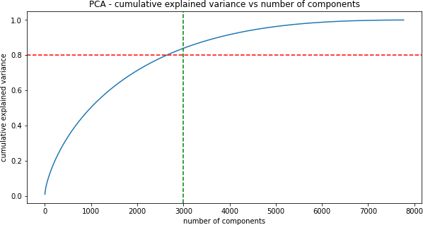
Principle Component Analysis:
As you can see that 100% of the variance is clarified by about ~7500 components.
Also, more than 80% of the variance is clarified just by 3000 components.
Hence to simplify the model, and decrease dimensionality, we take top 3000 components, which will still capable to capture more than 80% of variance.

Slide 24
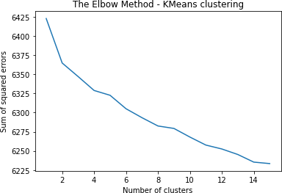
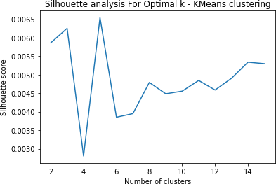
K-Means Clustering:
Visualizing the elbow curve and Silhouette score to decide on the best number of clusters for K- means clustering algorithm.
The sum of squared errors between each point and the centroid in a cluster reductions with the rise in the number of clusters.
The maximum Silhouette score is obtained for 5 clusters.
Building 5 clusters using the k-means clustering algorithm

Slide 25
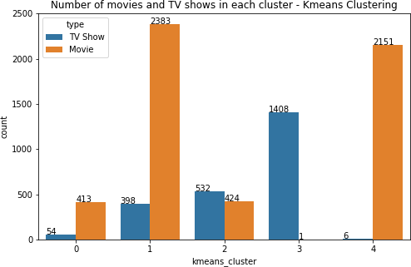
K-Means clusters:
Successfully built 5 clusters using the k-means clustering algorithm.
In cluster 0, 1 & 4 maximum number of count belong from Movie class.
Cluster 3 build on TV shows.

Slide 26
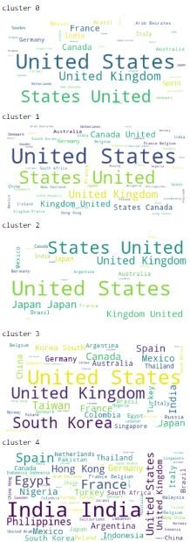
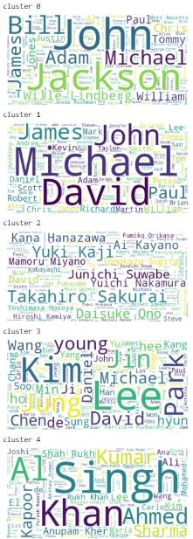
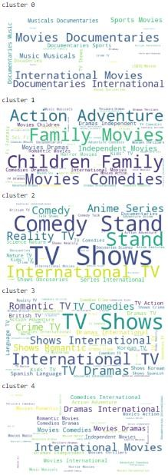
Word cloud for country
Word cloud for cast
Word cloud for genre

Slide 27
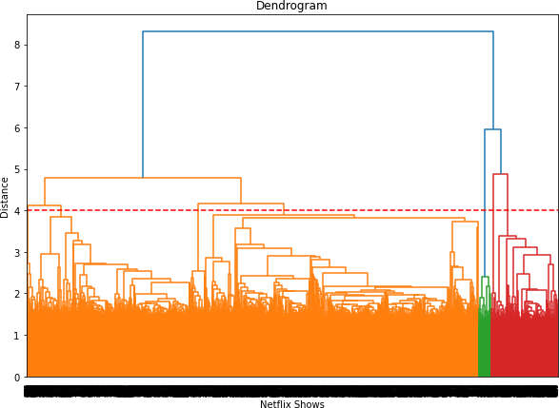
Agglomerative Hierarchical Clustering:
Visualizing the dendrogram to decide on the finest number of clusters for the agglomerative (hierarchical) clustering algorithm.
At a distance of 4 units, 7 clusters can be constructed using the agglomerative clustering algorithm.

Slide 28
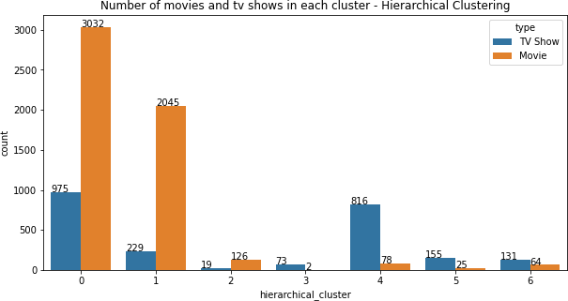
Agglomerative Hierarchical clusters:
Successfully constructed 7 clusters using the Agglomerative (hierarchical) clustering algorithm.
Highest number of datapoint build on cluster 0 & 1.

Slide 29
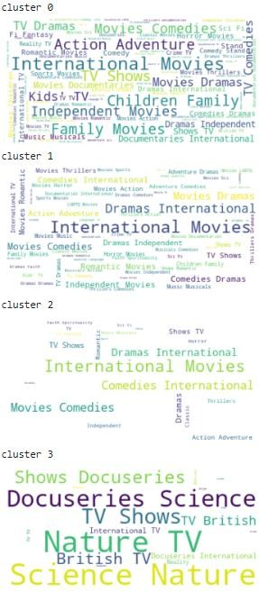
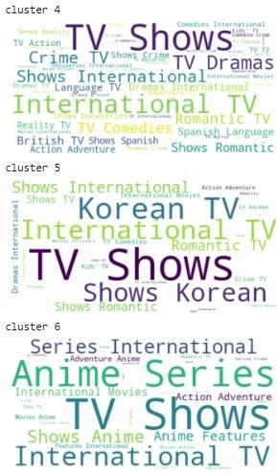
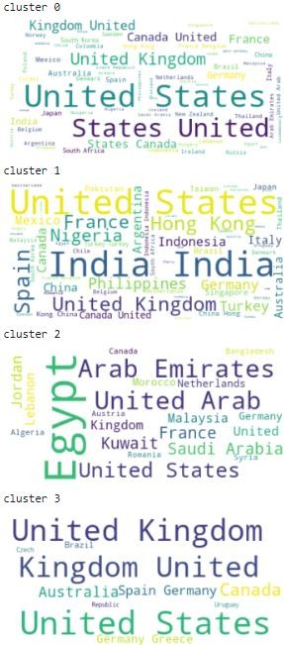
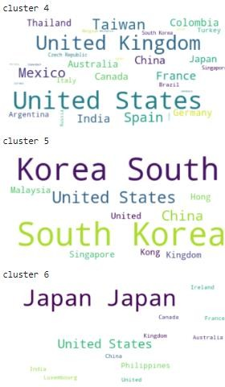
Word cloud for genre
Word cloud for country

Slide 30
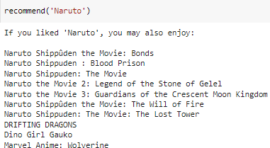
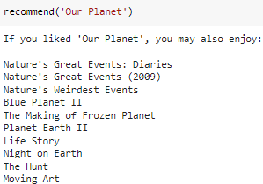
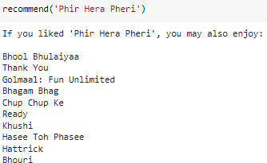
Recommendation System:
We can construct a simple content-based recommender system based on the similarity of the
movie/shows.
If a person has watched a show on Netflix, the recommender system must be capable to recommend a list of similar shows that s/he likes.
To acquire the similarity score of the shows, we can use cosine similarity.
The similarity between two vectors (A and B) is calculated by taking the dot product of the two vectors and dividing it by the magnitude value. We can simply say that the CS score of two vectors rises as the angle between them declines.

Slide 31
CONCLUSION:
In this project, we worked on a text clustering problem wherein we had to classify/group the Netflix shows into definite clusters such that the shows within a cluster are similar to each other and the shows in different clusters are dissimilar to each other.
The dataset contained about 7787 records, and 12 attributes. We began by dealing with the dataset's missing values and doing exploratory data analysis (EDA).
It was decided to cluster the data based on the attributes: director, cast, country, genre, rating and description. The values in these attributes were tokenized, preprocessed, and then vectorized using TFIDF vectorizer.
Through TFIDF Vectorization, we created a total of 10000 attributes.
We used Principal Component Analysis (PCA) to handle the curse of dimensionality. 3000 components were
capable to capture more than 80% of variance, and hence, the number of components were controlled to 3000.
We first constructed clusters using the K-Means Clustering algorithm, and the finest number of clusters came out to be 5. This was got through the elbow method and Silhouette score analysis.
Then clusters were constructed using the Agglomerative clustering algorithm, and the finest number of clusters came out to be 7. This was got after visualizing the dendrogram.
A content-based recommender system was constructed using the similarity matrix got after using cosine similarity. This recommender system will make 10 recommendations to the user based on the type of show they watched.

Slide 32
Thank You

